Slide 1

Natural Language Processing (NLP) Challenge
GROUP 3
by: Aryam - Dana - Randa - Ghadh

Slide 2
Project Overview
Tasks
Data
Goal
Process and clean the data.
A classified dataset data.csv includes a label (0: fake, 1: real).
To build a high-performing classifier model for distinguishing between fake and real news and test it on validation data.
classification model.
Results model.
The unclassified dataset validation_data.csv a includes label (2).
Predicting classification with new data

Slide 3





Data Preprocessing using NLP Techniques
Download Data
Download data and learn subject data
Clean Data
Removing symbols.
Converting uppercase letters to lowercase.
Extract Features
Convert text to numbers using TF-IDF
Train Data
Split data into training and testing.

Slide 4

Classification Models
Tested three different models for news headline classification:
1- Logistic Regression
2- Naive Bayes
3- RandomForest

Slide 5
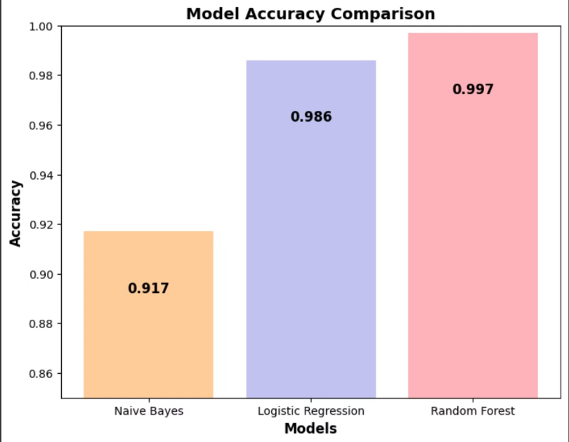
Observation Between Models:
Precision
Recall
F1- Score
Models
99.5%
99.7%
99.6%
RandomForest
91%
91%
91.2%
Naive-Bayers
98%
98%
98.5%
Logistic regression

Slide 6
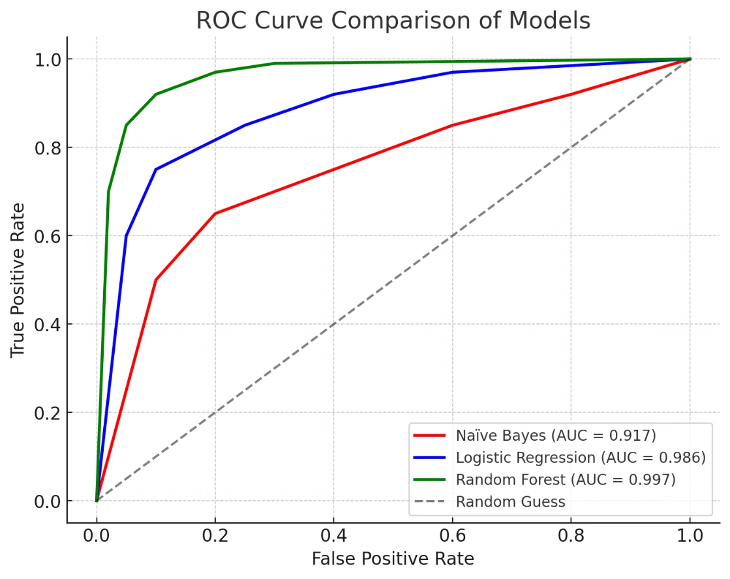
Our Model Final Evaluation – The ROC - AUC Curve

Slide 7

The Best Selected Classification - RandomForest Model
99.6%
99.7%
99.5%
99.6%
Accuracy
Recall
Precision
F1-Score

Slide 8

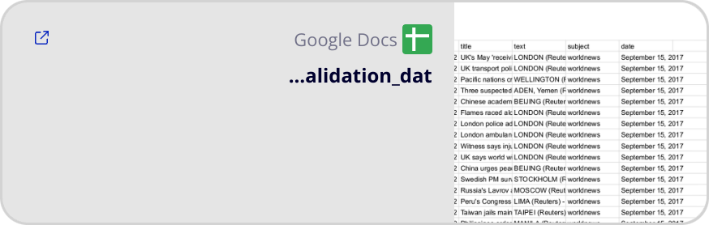
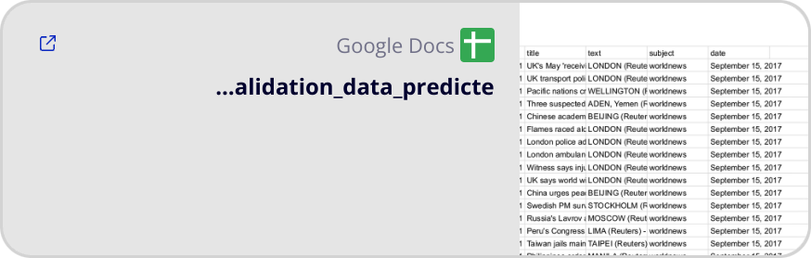
Predicting Classification:
Dataset before development:
Dataset after development:

Slide 9
Team work
Name
Aryam
Dana
Randa
Gadah
Task
Codeing
Codeing
Presentation
Presentation
Percent
25%
25%
25%
25%

Slide 10
Thank You!

